Slide 1
Nutrient intake profiles and patterns with respect to gender and income(NHANES)
Aashish Mathsyaraja
Abhay Hemanth

Slide 2

Motivation
The NHANES dataset includes nutrient intake of a large, diverse population all around the US.
Did the Nutrient profile patterns of people change over years?
Is there a difference in nutrient intake of people with respect to age, gender or Income?
Are majority of people eating a balanced healthy diet or unbalanced diet?
Are there any patterns in data which may be linked to causing obesity and other health issues?
Are people aware of their nutrient intake?

Slide 3
Steps involved
Data Acquisition and cleaning- Preprocess.
Clustering with DBSCAN with 5 dimensions( 5 macro-nutrients) and plotting it down to 2 dimensions using TSNE to observe patterns.
Plot differences in nutrient intake with respect to gender and income to poverty ratio.
Observe the Average macro-nutrient values for people above and below poverty line
Plot the percentage of people eating deficit amount of nutrients
Clustering with K-means with 2 dimension(carbs and fat) with varying income to poverty ratio.

Slide 4
Project Workflow

Slide 5
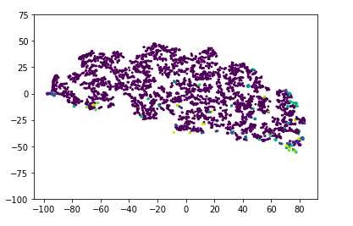
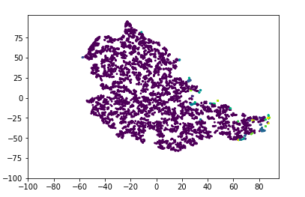

Clustering with DBSCAN
Macro-Nutrient pattern for Male
Macro-Nutrient pattern for Female

Slide 6
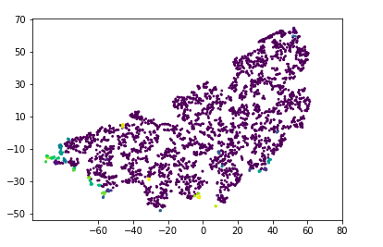
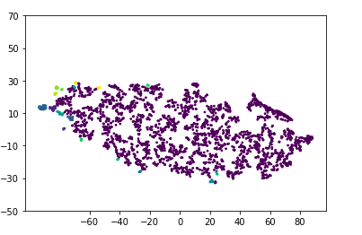
Clustering with DBSCAN-
Nutrient Pattern for people above poverty-line
Nutrient pattern for people below poverty-line

Slide 7
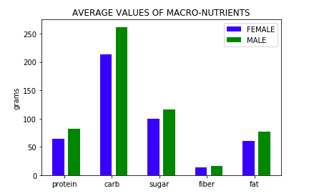
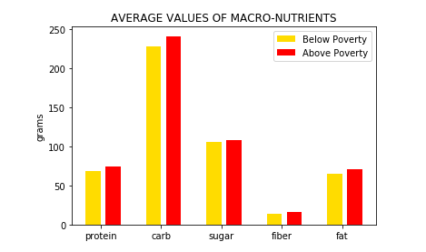
Nutrient intake plots
Intake profiles with respect to gender
Intake profiles with respect to Income

Slide 8
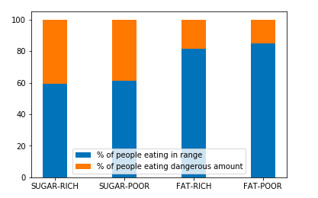
Nutrient intake plots- Poverty income ratio
Proportion of people eating excessive amounts of sugar
and fat plotted with respect to poverty to income ratio

Slide 9
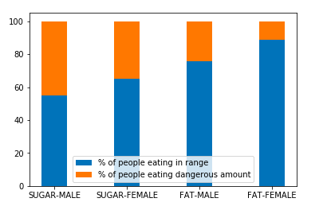
Nutrient intake plots- Gender
Proportion of people eating excessive amounts of sugar
and fat plotted with respect to Gender

Slide 10
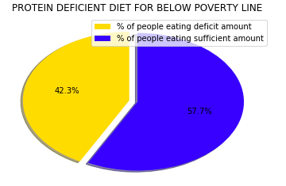
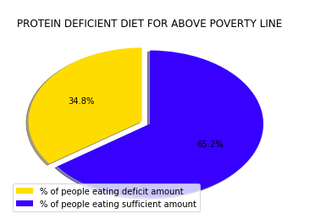
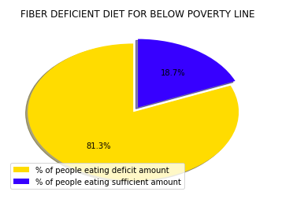
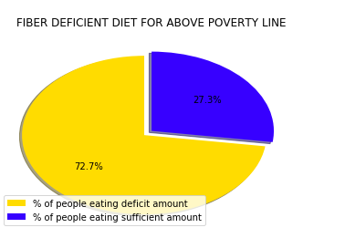
Nutrient intake profile- Deficient Macronutrients

Slide 11
Considerations:
About 33.5% of people in US are over-weight or Obese.
About 10% of overall people in US are diabetic type-2, and it increases to 25.2% above the age of 60.
Anything above 110 grams for sugar and 100 grams for fat a day is considered dangerous or excessive.
Anything below 56 grams for protein and 20 grams for fiber is considered a deficit
Sources:
https://health.gov/dietaryguidelines/2015/resources
http://www.diabetes.org/diabetes-basics/statistics/
https://www.cdc.gov/obesity/data/adult.html

Slide 12
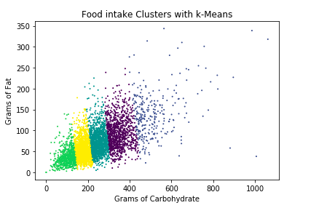
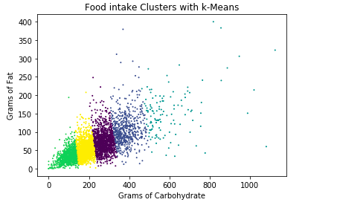
Clustering with K-means
K-means cluster for population
below poverty line
K-means cluster for population
above poverty line

Slide 13
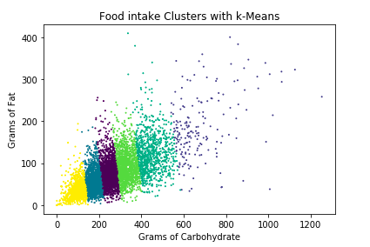
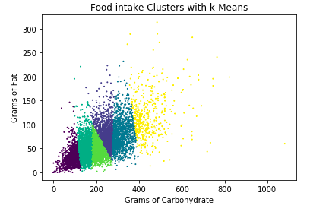
Clustering with K-means:
K-means cluster-Male
K-means cluster-Female

Slide 14
Conclusion:
Nutrient intake patterns are plotted with respect to gender and Income, Observable difference in pattern is observed.
About 40% of people are eating excessive amount of sugar on daily basis, About 25% of people are eating excessive amount of fat.
Majority of people in every category are eating deficient amount of Protein and Fiber. Deficiency is observed more in case of people below poverty than people above poverty line.
Majority of people aren’t aware of their nutrient intake. This may be a crucial factor causing health issues like Diabetes in long run.

